Slide 1
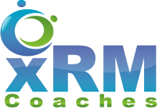
Eliminating Technical Debt
POWER PLATFORM

Slide 2
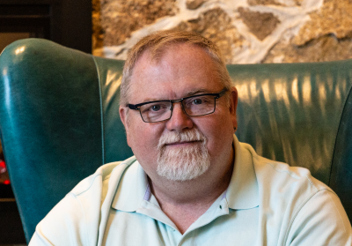
Mitch Milam
mitch@xrmcoaches.com
@mitchmilam
linkedin.com/in/mitchmilam
youtube.com/xRMCoaches
Subscribe!

Slide 3
Dynamics 365 Training
http://learn.xrmcoaches.com
JavaScript Training
Free and Paid courses

Slide 4
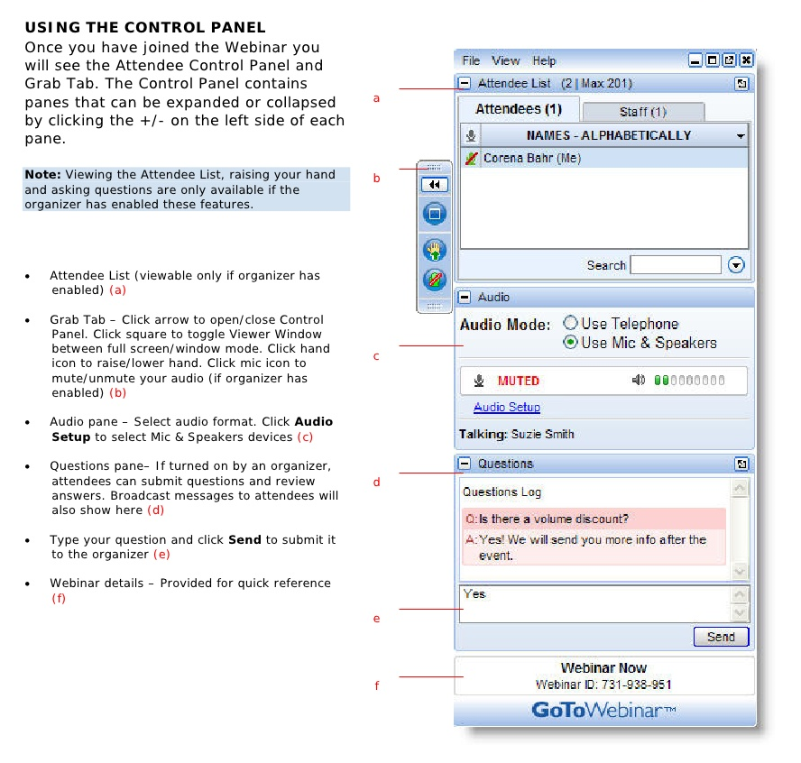
Webinar Housekeeping

Slide 5
Recent Story

Slide 6
General Cleanup
Workflows
Before: 298
After: 241
Solutions
Before: 150
After: 70

Slide 7
Leads
Custom Fields
Before: 195
After: 121
Views
Before: 32
After: 14

Slide 8
Opportunity
Custom Fields
Before: 330
After: 304
Views
Before: 135
After: 30

Slide 9
Security
25 people had System Administrator and/or Office 365 Global Admin access

Slide 10
The Process

Slide 11
The Five R’s of Technical Debt Removal
Review
Remove
Reorganize
Reimagine
Relaunch

Slide 12
The Five R’s of Technical Debt Removal
Review
Remove
Reorganize
Reimagine
Relaunch

Slide 13
The Five R’s of Technical Debt Removal
Review
Remove
Reorganize
Reimagine
Relaunch

Slide 14
The Five R’s of Technical Debt Removal
Review
Remove
Reorganize
Reimagine
Relaunch

Slide 15
Things to remember
This will probably be a painful process
There is just a LOT of manual labor
Every situation is different
There is no boiler plate solution

Slide 16
When was Dynamics installed?
The original version of Dynamics may play a role in your decision
Age of the system may or may not play a role

Slide 17
Tools

Slide 18
Toolbox
XrmToolbox
SnapShot!
Just Decompile

Slide 19
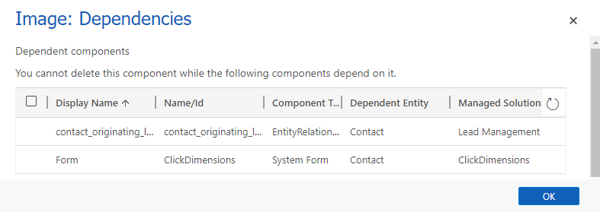
Built-In: Show Dependencies

Slide 20
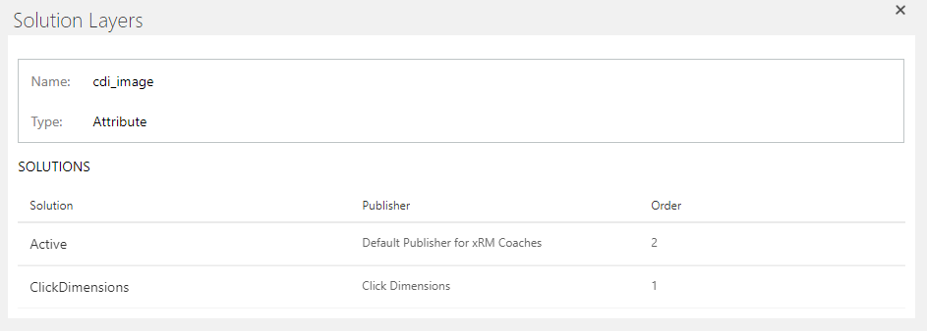
Built-In: Solution Layers

Slide 21
Review

Slide 22
Stage 1
Entities
Fields
Solutions
Processes
Plugins/Plugin Steps

Slide 23
Stage 2
Security Roles
Security Role usage
Office 365 Administration access

Slide 24
Stage 3
Forms
Views
System
User-Defined
Charts
Apps

Slide 25
Stage 4
JavaScript
Other Web Resources
HTML
Images
Templates
Email
Word

Slide 26
Review Point
What to do next?
Rebuild
Migrate
Recreate

Slide 27
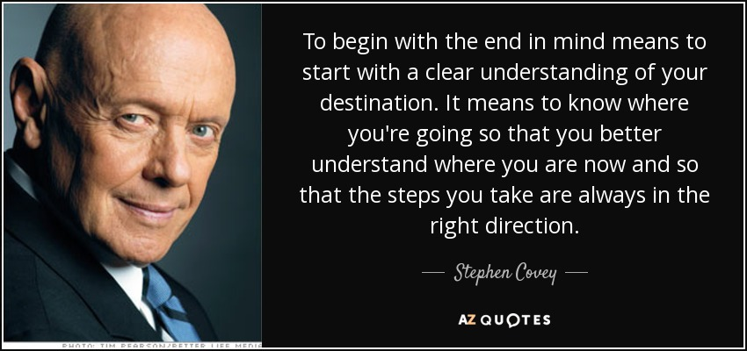

Slide 28
Checkpoint
Do not proceed without buy-in
Management
User community

Slide 29
Methodologies
Iterative
Waterfall

Slide 30
Remove

Slide 31
Multiple Organizations
Sandbox2
Sandbox
Production

Slide 32
The Solution Issue
How do you deploy?
Managed solutions or
Unmanaged solutions
Managed vs unmanaged will determine your cleanup methodology

Slide 33
Start with the Low-Hanging Fruit
Unused entities
Unused/draft processes
Inappropriate security role access

Slide 34
Work Back to Front
Remove components that do not affect the user first

Slide 35
Tech-Tip: Apps
Using the App model, you don’t actually have to remove things, just don’t show them

Slide 36
Reorganize

Slide 37
What Do You Not Like?
What makes your job harder?
Can it be corrected?
Then how can it be corrected?

Slide 38
Reimagine

Slide 39
Goals
Better, faster, stronger
More streamlined
Less, is more

Slide 40
Ask Yourself, and the Users
Is the company today, the company it was when we first installed this product?

Slide 41
Involve the User Community
What is it they really need to see to do their job?
What would make their job easier?
What drives them crazy?

Slide 42
Unified Interface
The switch to UCI is the perfect time to make changes
Mostly because we don’t have a choice
Secondly, because it is a better UI

Slide 43
Apps
Are you using Apps to focus the user’s attention on their job?

Slide 44
Relaunch

Slide 45
Execution
Develop your roll-out plan
Get the plan approved
Over Communicate the plan
Execute the plan
Review your execution

Slide 46
Final Points

Slide 47
Plugin Source Recovery
Can be exporting from the system using the XrmToolbox Plugin: Assembly Recovery Tool
Can be decompiled using Just Decompile

Slide 48
Data Type Conversion
Data type conversion, if necessary, continues to be an issue and is a hard problem to solve

Slide 49
PCF Controls
PCF Gallery
https://pcf.gallery
Tons of ready-to-use controls to add functionality to Dynamics model-driven apps

Slide 50
System Job Review
Reviewing failed or waiting system jobs may be a way to locate unknown or undiscovered issues

Slide 51
Questions?

Slide 52
Thank You

